Slide 1

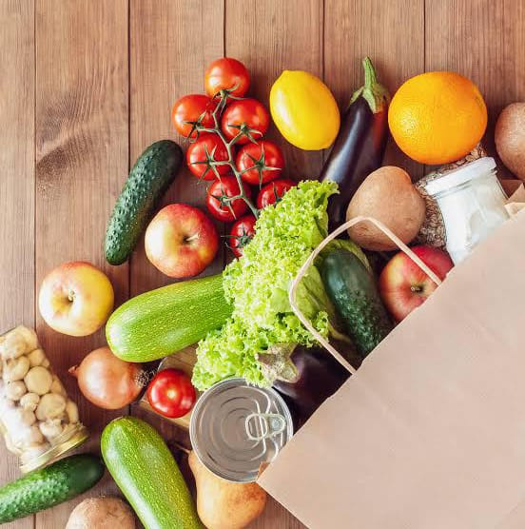


Anusha & Jiya
ORGANO
Affordable grocery at your door-step.
Fresh. Complete. Convenient.
Free Shipping
Fresh Vegetables
Good Price

Slide 2




OUR TEAM
Anusha Gupta
Jiya Singh
B.TECH CSE CORE
B.TECH CSE CORE

Slide 3
TABLE OF CONTENTS
01
Introduction
06
Conclusion
02
About Our Idea
07
Thank You
03
Working Principle
04
Marketing Strategies
05
SWOT Analysis

Slide 4

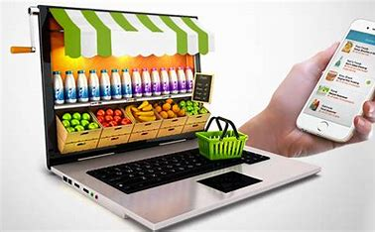
INTRODUCTION
Online grocery shopping is a convenient and modern way to purchase groceries and other household essentials through the internet. Instead of visiting a physical store, you can browse through a wide range of products on a grocery app or website. You can add items to your virtual cart, just like you would in a physical store. Once you've completed your shopping, you can review your cart, make any necessary adjustments, and proceed to checkout.
Shopping online for groceries is a great way to save time and money. Online grocery shopping has been around for about ten years, but people have only started taking advantage of this convenient new trend recently.
Avoiding travel and reduces number of cars on the road.
Personalized recommendations based on previous orders and choices.

Slide 5

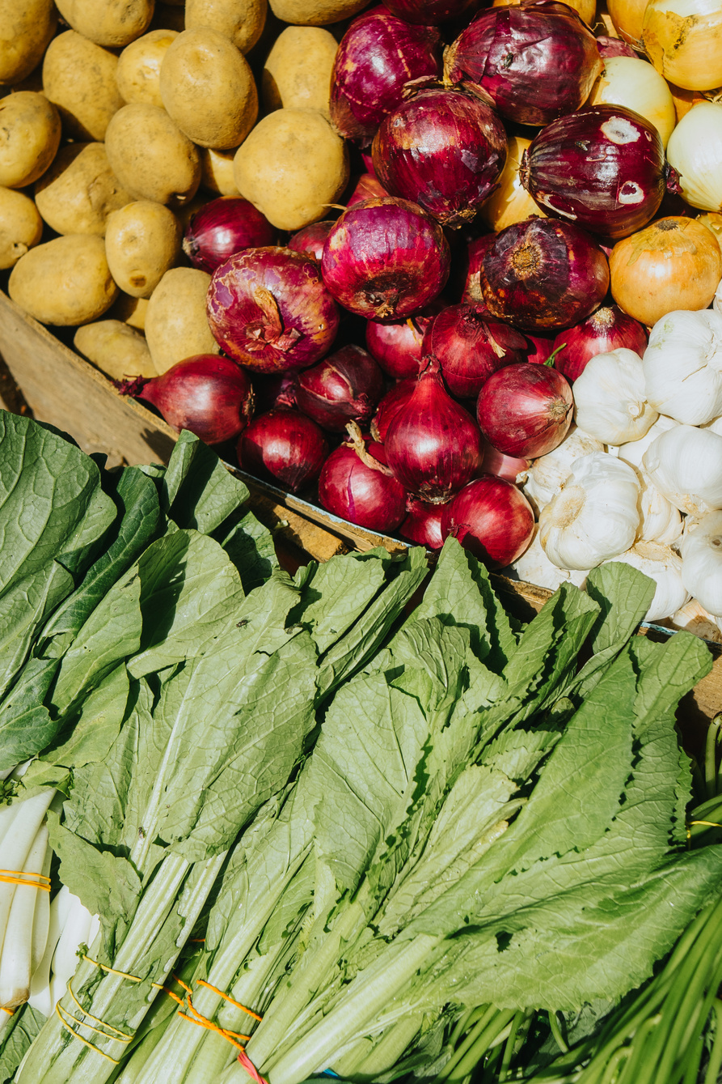


ABOUT OUR IDEA
Our idea includes creating an app designed to help users manage their grocery costs and make informed shopping decisions.
Its primary features include cost tracking, price comparison, and personalized recommendations and showcasing different deals and discounts across different apps and sites (or local stores nearby), and helping In choosing the best and cheapest option.
With a user-friendly interface, local sellers can also showcase a vast selection of products and along with tie-ups with available grocery shops and sites our app makes grocery shopping a breeze.
Special Location Based Deals
Everyday Offers and Deals
Real-time Price and Deal Tracking

Slide 6
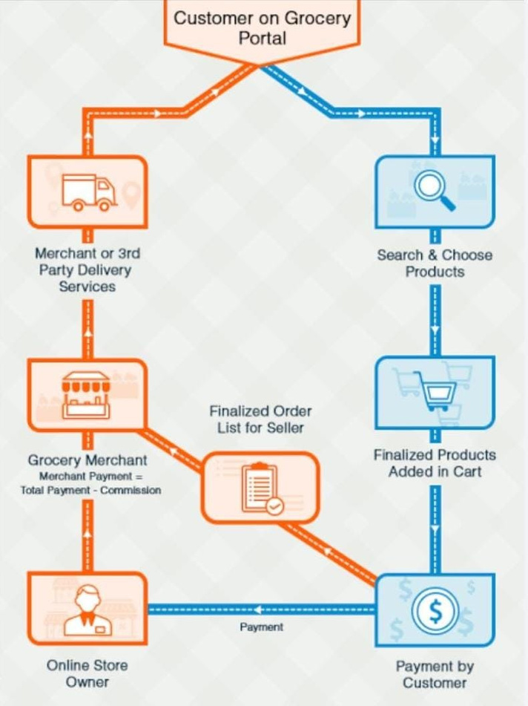
WORKING PRINCIPLES
The core technology includes data aggregation, price comparison algorithms, online payment and communication with vendors and users.
App likely uses real-time data integration to fetch prices from local vendors and online platforms.
It compares these prices and presents users with options and displays a list of prices for the requested items, helping users identify the best deals and lowest prices.
The app also provides additional features, such as reviews, product details, and the ability to create shopping lists.

Slide 7

MARKETING STRATEGIES
1. Local Partnerships: Forging partnerships with local grocery stores. Offering them the opportunity to promote their products through the app in exchange for exclusive deals or discounts for your app users.
2. Geo-Targeted Ads: Using location-based targeting to show ads to users in specific areas where our app operates.
3. Free Trials and Promotions: Offering a limited-time free trial or exclusive discounts to new users. Thereby encouraging them to try out the app's features and experience its value.
4. Loyalty Program: Rewarding loyal users with points or discounts for using the app consistently. This can help retain existing users and encourage it's consistent use.

Slide 8
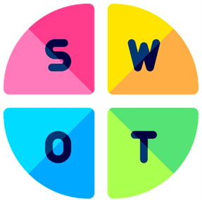
UNIQUE SELLING POINTS
SWOT ANALYSIS
SUPPORT OF LOCAL BUSINESSES
WANTS OF CUSTOMERS
Real-time Updates, Accurate Information, Reminders about everyday deals, Reliability and proper service.
Showcasing local stores and their offerings, helping small businesses gain more visibility and customers.
TRANSPARENCY
OFFERS & DEALS
Displaying prices from different stores, allowing users to make well-informed purchasing decisions based on their budget and preferences.
Finding the best deals and discounts available in their area, helping them save money on their grocery and vegetable purchases.

Slide 9
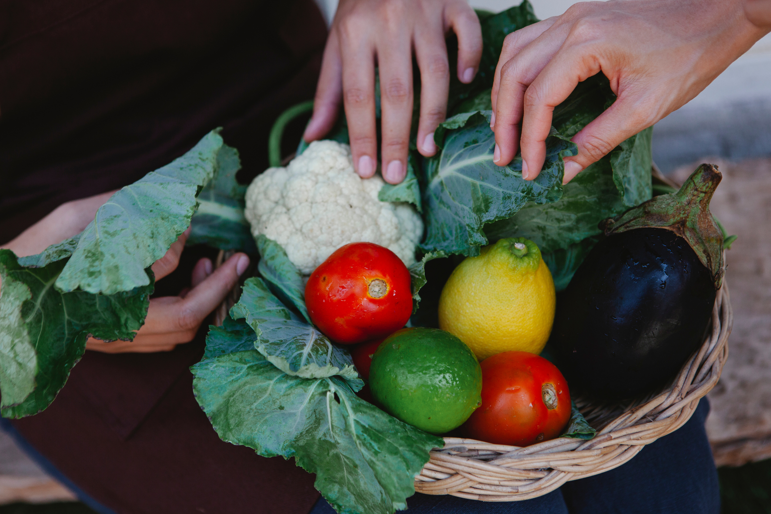
CONCLUSION
In conclusion, the grocery comparison and delivery app serves as a valuable tool for modern consumers. It empowers users to easily compare prices across different platforms, enabling them to find the best deals and potentially save money on their grocery purchases. By incorporating information from both online apps and nearby local markets, the app caters to a wide range of shopping preferences. The added benefit of grocery delivery enhances convenience, saving users time and effort. Overall, the app streamlines the shopping experience, promotes smart spending, and aligns with the evolving trends of digital convenience in retail.

Slide 10

THANK YOU

